Slide 1

Hospital Administration Chatbot Using Deep Learning
An intelligent conversational agent built to streamline operational inquiries, automate scheduling logistics, and reduce manual administrative overhead.
1.AISHATH REHAM
2.AISWARYA P S
3.SIVANI
4.SOUMYA
5.SHANKAR UNNIKRISHNAN

Slide 2







Objective of the Project
Intelligent Automation
Appointment Handling
Operational Efficiency
Develop an adaptive, deep learning-powered chatbot system designed specifically to handle complex clinical administration flows and immediate inquiry answering.
Provide patients with end-to-end self-service scheduling workflows. Patients can complete reservations and cancel existing bookings completely automated.
Significantly minimize reception and front-desk administrative friction, re-allocating valuable hospital human resources to high-criticality patient care duties.
By providing standard automated FAQs, patients receive instantaneous responses, improving satisfaction and retention rates.

Slide 3




Administrative Datasets & Statistics
Administrative Table | Features Profiled | Data Shape / Volume
Patients Dataset | patient_id, first_name, last_name, gender, contact, insurance_provider | (50, 10) / 50 records
Doctors Dataset | doctor_id, specialization, experience, timings, profile_details | (10, 6) / 10 records
Appointments Dataset | appointment_id, patient_id, doctor_id, appointment_date, status | (200, 7) / 200 records
Synthetic Core FAQ | Parking, Pharmacy, Cafeteria, Wheelchair Access, Timings | Custom intent-mapped arrays
Structured Context Integration
The core model correlates dynamic database queries from Patients, Doctors, and Appointment states to support contextual transactions and confirm logic integrity.
Manually Created Knowledge Base
To assure high availability for facilities questions, manual FAQ mappings were synthesized to handle general conversational protocols, greetings, and structural details.

Slide 4


End-to-End System Workflow
User Input
Preprocessing & NLP
LSTM Class Prediction
Action/Response
Standard language query submitted by patient (e.g. scheduling request).
Tokenization and sequences mapping with standard padding layers.
Triggers appointment SQL queries or outputs direct facility context answers.
The core neural network predicts intents across trained health domains.
SOFTWARE STACK & APIS UTILIZED

Slide 5
Core Deep Learning Engine: LSTM
Sequential Layer Stack
Intent Classes & Specialization
The model classifies sequence prompts into high-level medical operational intents: Appointment Booking, Appointment Cancellation, Doctor Availability, Insurance validation, Facility operations, Emergency context, and common FAQs.
Input Processing
Raw Query Input Vectors
Embedding Layer
Tensor Dimension Mapping
Key Advantages of utilizing LSTM:
D deep LSTM Layer
Sequential Context Mappings
Sequential Capability: Processes sequential textual patterns perfectly.
Dense & Softmax
Intent Probability Matrix
Contextual Retention: Remembers short-term word structures essential for mapping precise conversational targets.
Efficiency: Highly scalable for multi-class medical intent routing.

Slide 6










Interactive Streamlit Application Interface
Greeting & Timings
Booking Intention
Booking Success
Cancellation Flow
Facilities & Insurance
Conversational greeting protocol and detailed clinical operating hours verification.
Interactive forms capturing key patient inputs (Name, Contact, Address details).
Dynamic database write-back assigning a uniquely tracking Patient Appointment ID.
Real-time appointment voiding routines utilizing indexed system booking IDs.
Direct query extraction mapping medical facilities, parking lists, and valid insurers.

Slide 7




Performance Results & Conclusion
System Validation Summary
The LSTM model exhibits robust optimization during training with minimal loss convergence divergence, ensuring accurate medical intent understanding during real-time queries.
TRAINING ACCURACY
Future System Enhancements
Acoustic Conversational Unit: Integrate speech-to-text NLP interactions.
Live EHR Integration: Real-time production Database synchronization.
Real-time Physician Track: True online doctor tracking systems.
VALIDATION ACCURACY

Slide 8
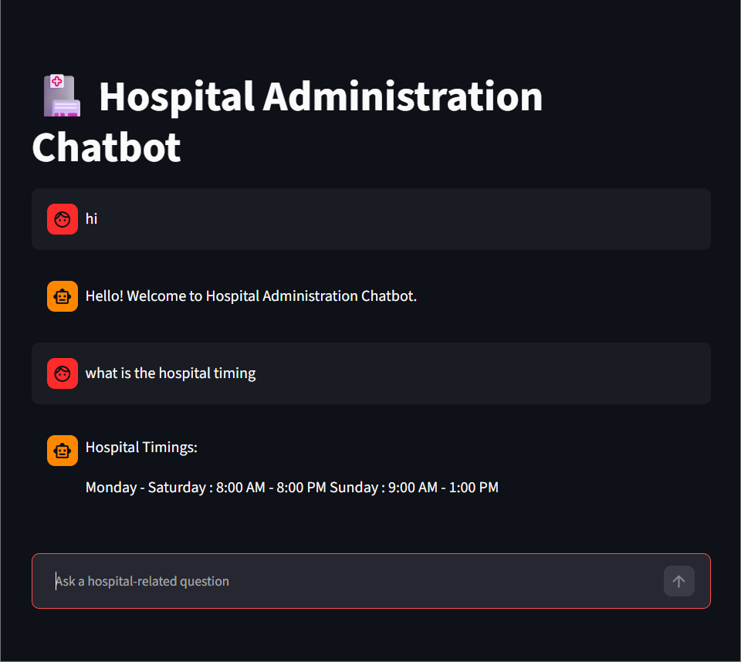
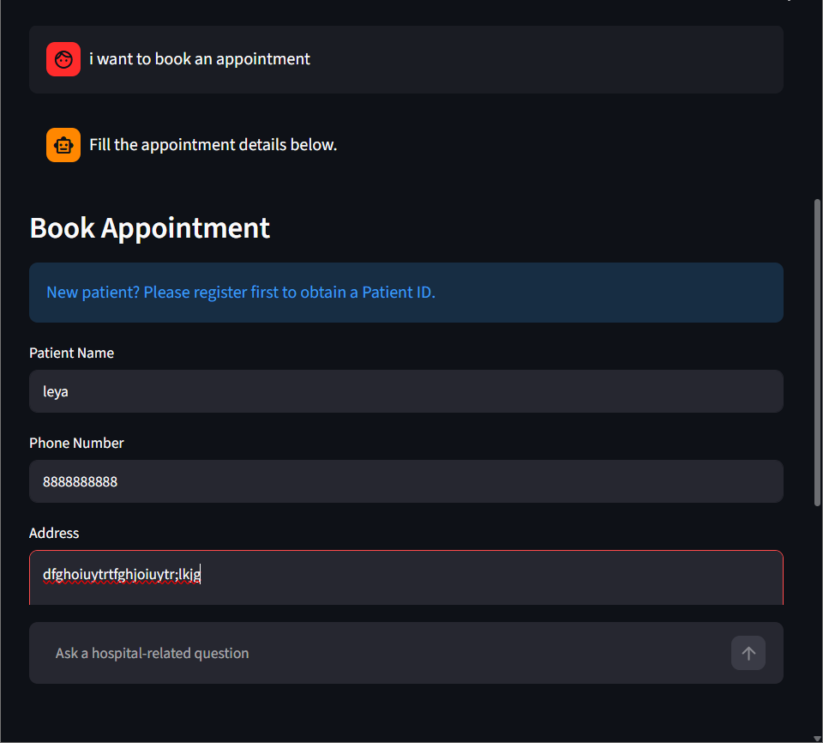
UI Screenshots

Slide 9
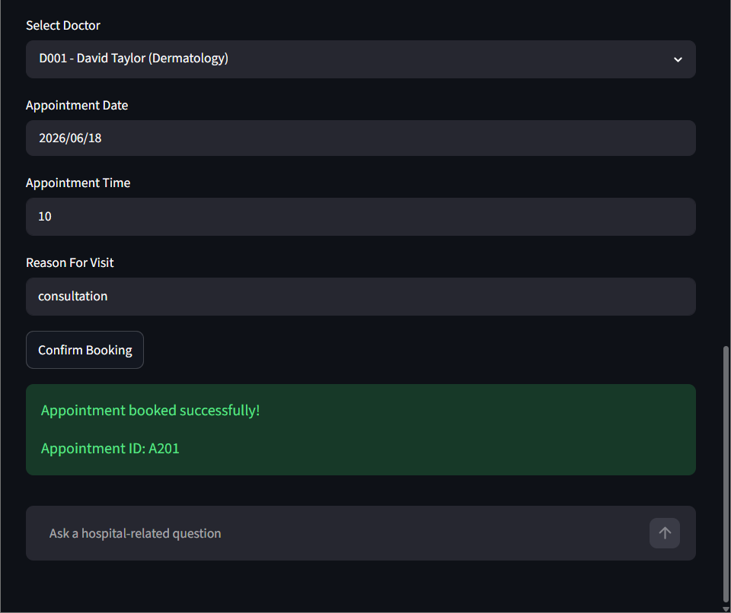
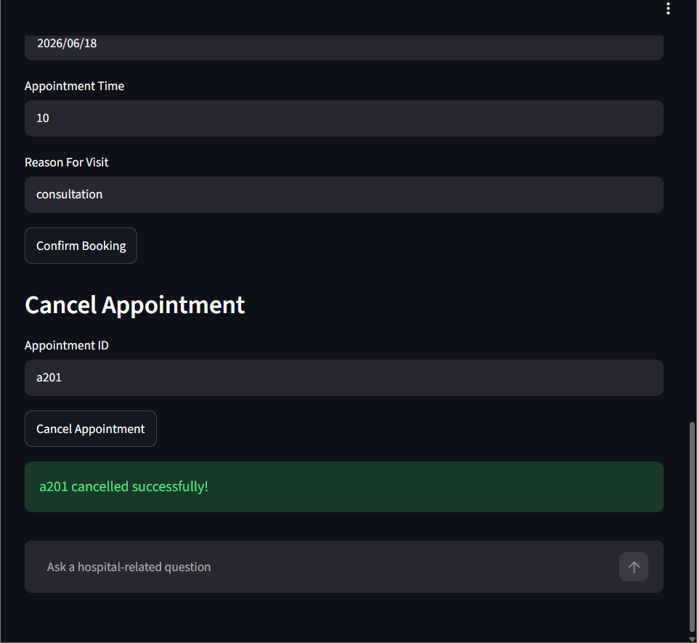
UI Screenshots

Slide 10
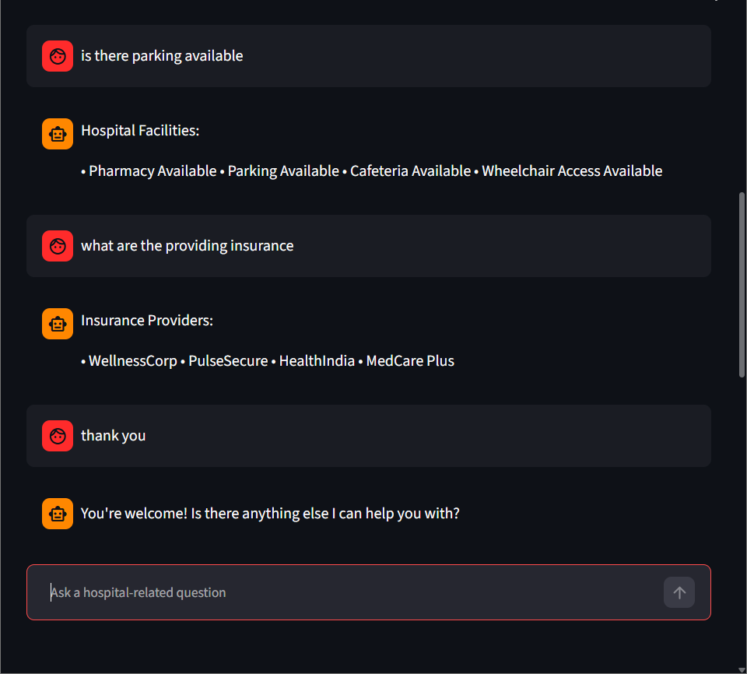
UI Screenshots

Slide 11
THANK YOU!...

